Slide 1

#RahoAmbitious
TechM Full Stack Software Development

Slide 2



Lecture On: Introduction to Front-End Technologies and Getting Started with HTML
Instructor: Rushabh Shah

Slide 3

Today’s Agenda
What is Front-End Web Development?
How to Create Websites and Web Applications?
What are the Three Ingredients of a Website?
Introduction to the World of HTML

Slide 4
The World of Front-End Web Development

Slide 5



The World of Front-End Web Development
Parts of a Website
Visuals
Behind-the-Scenes
Data
For example, Posts, Buttons, Sidebar, and Photos on Facebook
For example, clicking on a profile shows details about that profile only
For example, photos of your friends, your personal data and suggestions
Front-End
Back-End
Database

Slide 6
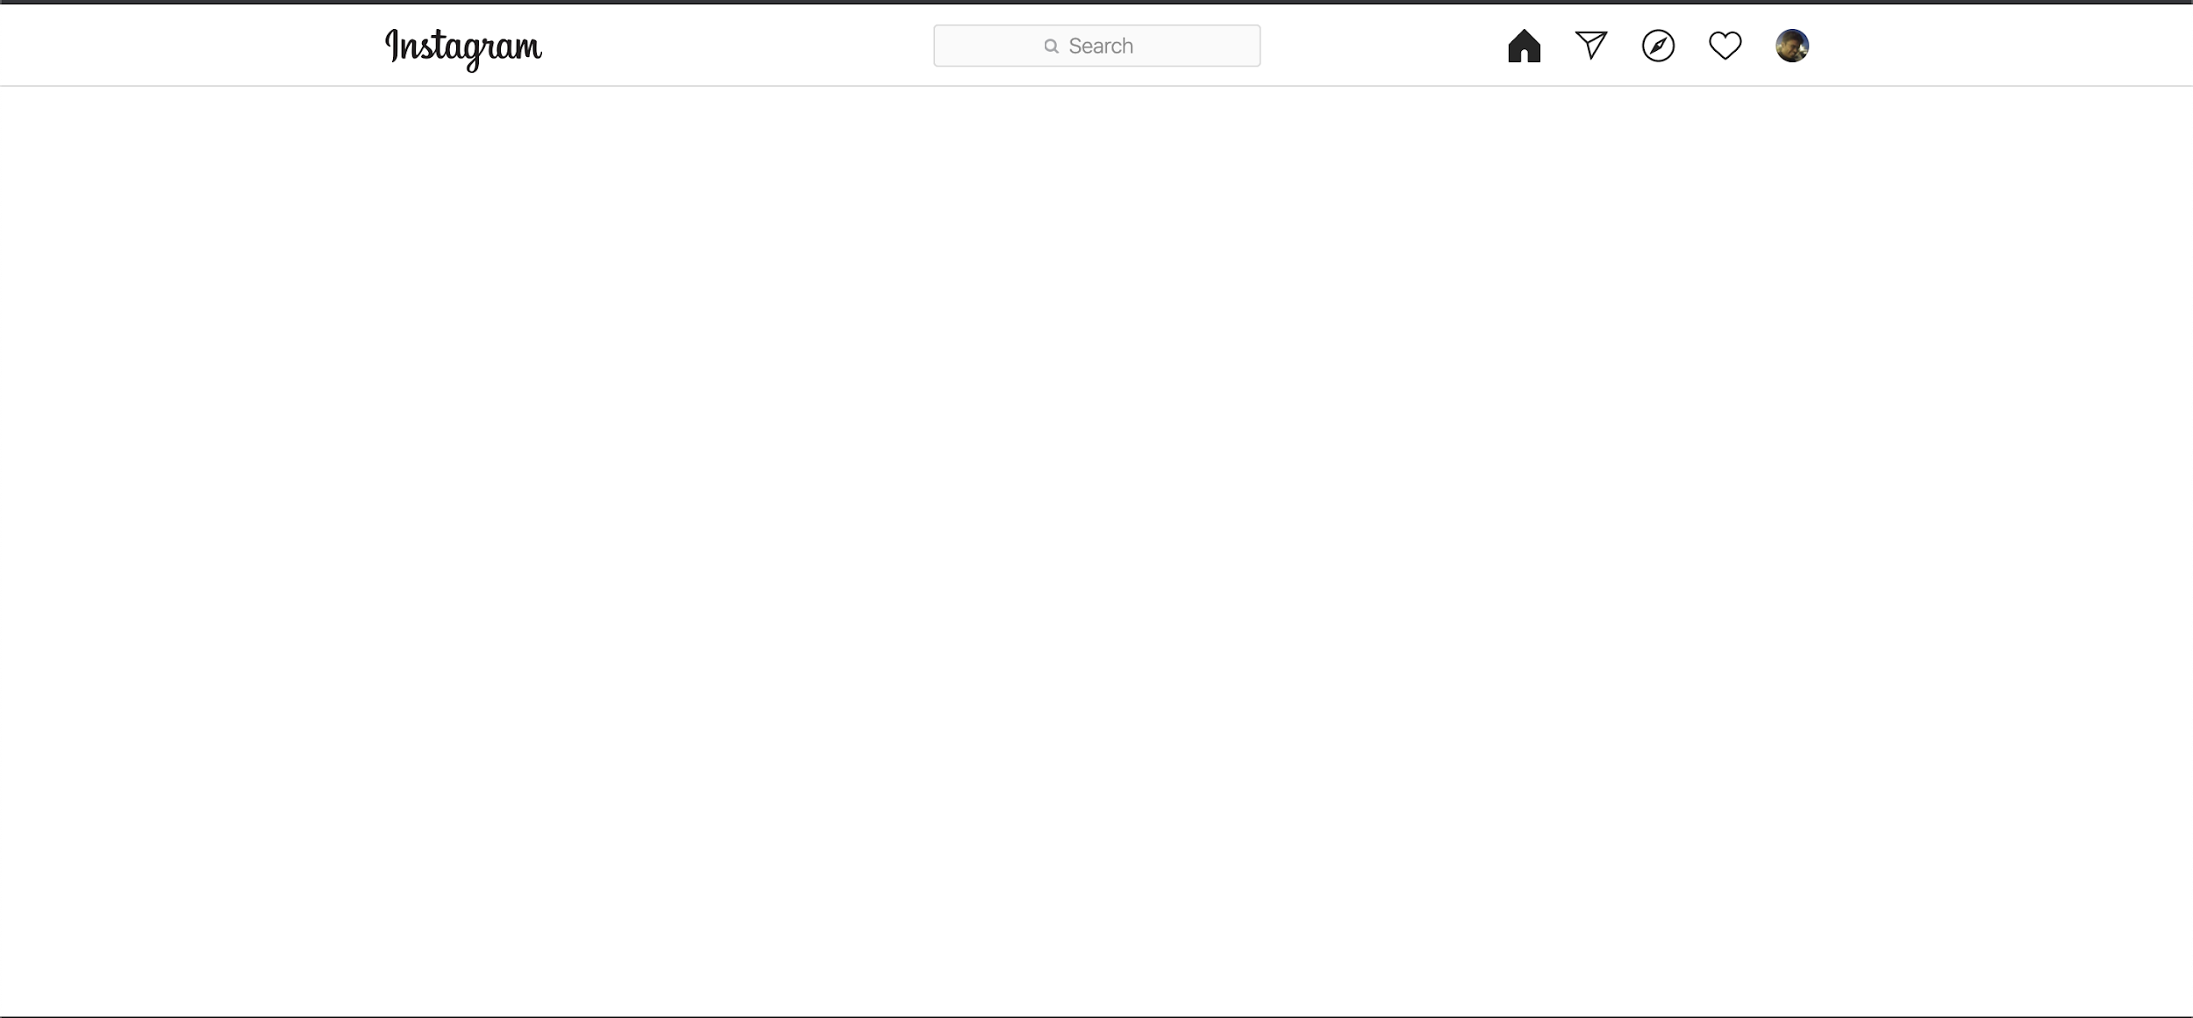
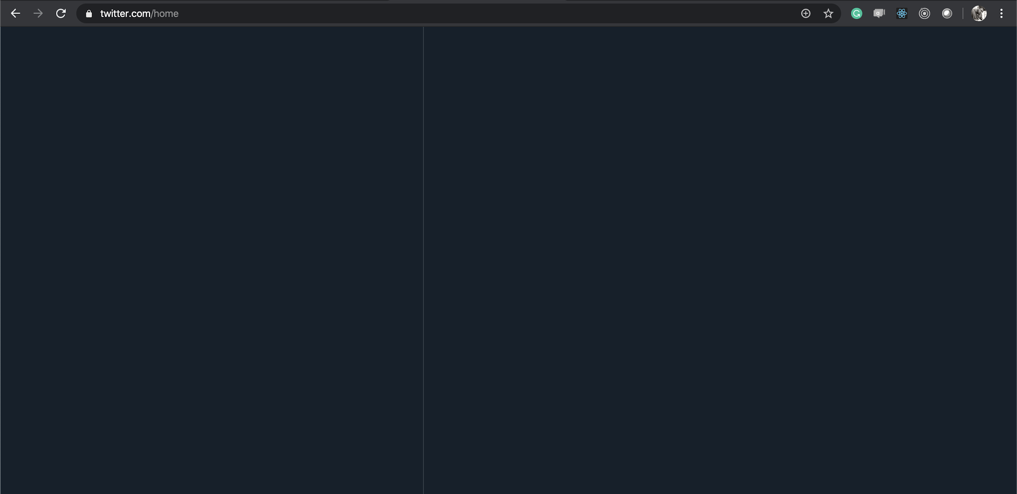
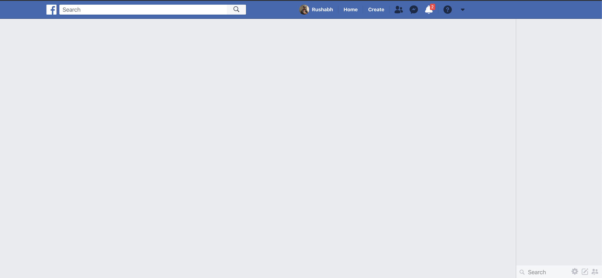
The World of Front-End Web Development
A World Without Front-End Development

Slide 7
The World of Front-End Web Development
Role of a Front-End Web Developer
Creating the user interface for the web application
Bringing the application alive
Helping the user ‘use’ the application
Converting the back-end and the data set to meaningful visuals

Slide 8



The World of Front-End Web Development
Three Ingredients of a Website
Foundation
Style
Functionality
(HTML)
(CSS)
(JS)

Slide 9



The World of Front-End Web Development
Three Ingredients of a Website
Foundation
Style
Functionality

Slide 10

The World of Front-End Web Development
Static Websites vs Dynamic Websites
Static Website | Dynamic Website
The content present on the web page cannot be modified at runtime. | The content present on the web page can be modified at runtime.
There is no interaction with the database. | The website can interact with the database.
It is cheaper to develop a static website as compared to a dynamic website. | A dynamic website requires more cost of development than a static website.
The same content gets loaded every time. | The content that gets loaded may vary as per requirements.
Note: The term ‘static websites’ does not mean they will not respond to user actions. They are called ‘static’ because they cannot interact with the server or database.

Slide 11



Poll 1 (15 Sec)
Which of the following statements about static websites is true?
The content present on the static websites can be modified at runtime.
Static websites can be manipulated using server-side communication.
It is possible to interact with static websites database.
The content present on the static websites cannot be modified at runtime.
Practice in teams of 4 students
Industry expert mentoring to learn better
Get personalised feedback for improvements
11

Slide 12
Poll 1 (Answer)
Which of the following statements about static websites is true?
The content present on the static websites can be modified at runtime.
Static websites can be manipulated using server-side communication.
It is possible to interact with static websites database.
The content present on the static websites cannot be modified at runtime.
Practice in teams of 4 students
Industry expert mentoring to learn better
Get personalised feedback for improvements
12

Slide 13
Poll 2 (15 Sec)
Which of the following statements about dynamic websites is/are true?
Note: More than one option can be correct.
Dynamic websites can be manipulated using server-side communication.
The content present on the dynamic websites cannot be modified at runtime.
The content present on the dynamic websites can be modified at runtime.
Dynamic websites are less versatile as compared with static websites.
Practice in teams of 4 students
Industry expert mentoring to learn better
Get personalised feedback for improvements
13

Slide 14
Poll 2 (Answer)
Which of the following statements about dynamic websites is/are true?
Note: More than one option can be correct.
Dynamic websites can be manipulated using server-side communication.
The content present on the dynamic websites cannot be modified at runtime.
The content present on the dynamic websites can be modified at runtime.
Dynamic websites are less versatile as compared with static websites.
Practice in teams of 4 students
Industry expert mentoring to learn better
Get personalised feedback for improvements
14

Slide 15

Course Overview
Along the course, you will learn about the following technologies:
HTML
CSS
JavaScript
JSON
AJAX
The project that we will be building along the course using the technologies mentioned above is the
Food Recipes Website.

Slide 16
Doubt Clearance (5 min)

Slide 17
Introduction to HTML

Slide 18
Introduction to HTML
HTML: HyperText Markup Language
Hypertext: Text which contains hyperlinks (or references) to other text.
Markup Language: It is a way in which the documents are annotated such that it can be systematically distinguished from the normal text.
HTML is a set of markup symbols intended for displaying content on the Internet.
Markup tells browsers how to display the content of a webpage, that is, the words and images. Markups are commonly known as tags.
The HTML file is broken into small parsing elements called Tokens, which are read by the browser.

Slide 19
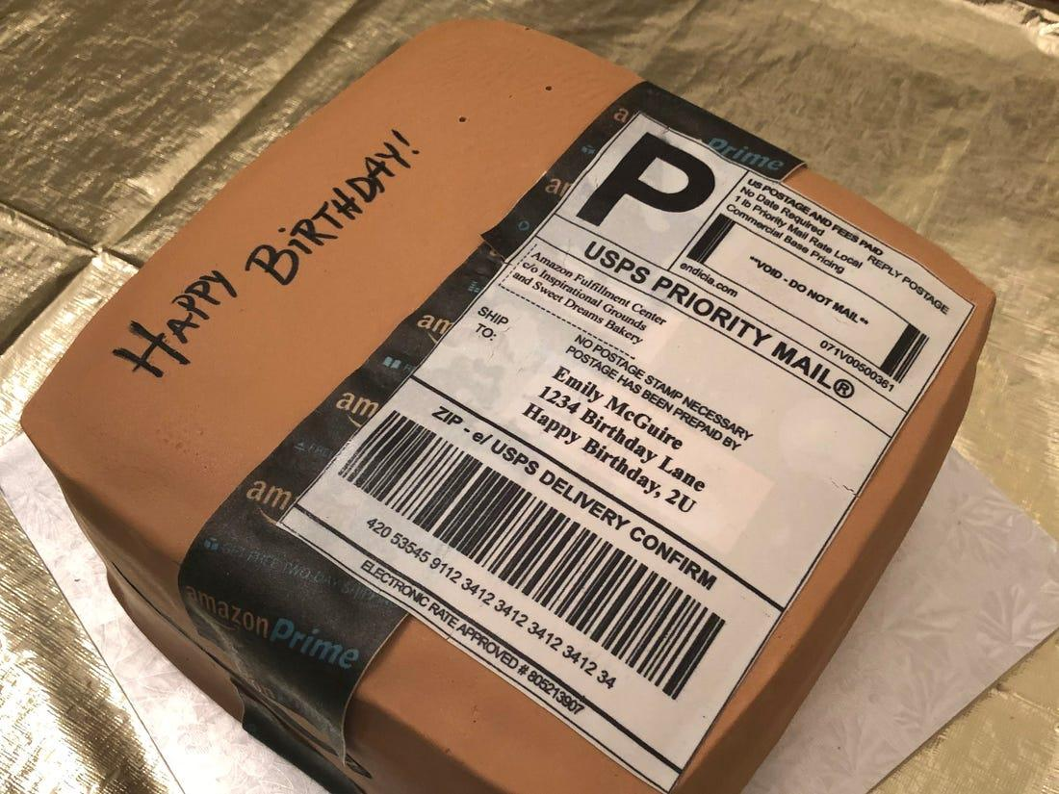
Introduction to HTML
HTML Structure
HTML Container
A container that holds the content and the information about the content
Head
Information about the content
Body
Content

Slide 20
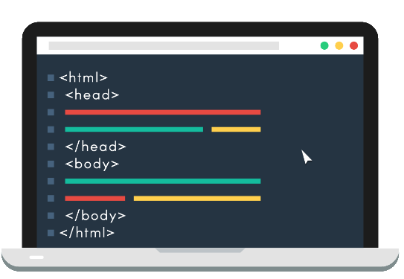
Introduction to HTML
HTML Structure

Slide 21
Poll 3 (15 Sec)
What is the full form of HTML?
High Text Markup Language
Hyper Test Markup Language
Hyperlink Text Markup Language
HyperText Markup Language
Practice in teams of 4 students
Industry expert mentoring to learn better
Get personalised feedback for improvements
21

Slide 22
Poll 3 (Answer)
What is the full form of HTML?
High Text Markup Language
Hyper Test Markup Language
Hyperlink Text Markup Language
HyperText Markup Language
Practice in teams of 4 students
Industry expert mentoring to learn better
Get personalised feedback for improvements
22

Slide 23
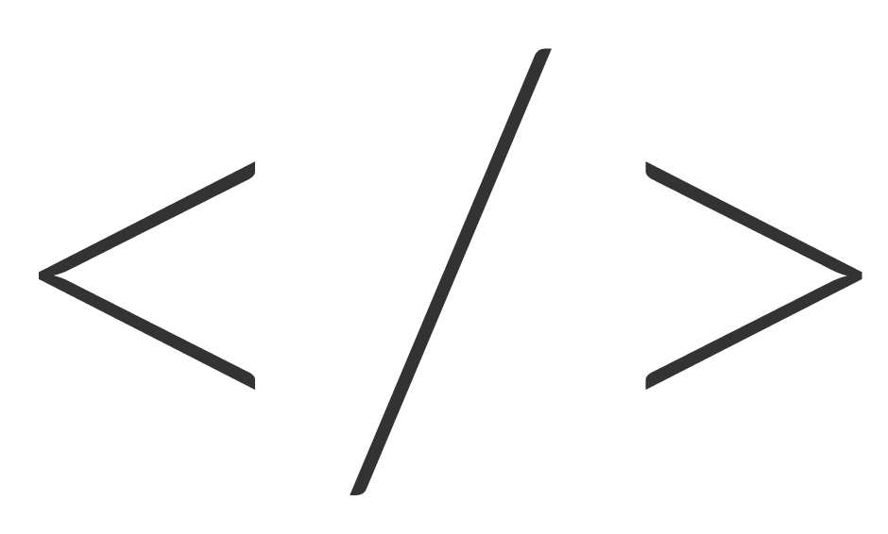
HTML Tags
Introduction to HTML

Slide 24
Introduction to HTML
HTML Tags
Some of the common HTML tags
<h1></h1>...<h6></h6>
<p></p>
<a></a>
<span></span>
<div></div>
<select></select>
<table></table>
Tag Name
<h1>This is a header</h1>
Content
Closing Tag
Opening Tag
HTML Element

Slide 25
Introduction to HTML
Self -Closing HTML Tags
Some of the self-closing tags
<img />
<br />
<input />
<hr />
Tag Name
<br />
Opening Tag
Closing Tag
HTML Element

Slide 26
Introduction to HTML
HTML Tags with Attributes
Tag Name
Attribute Name
Attribute Value
<h1 class=“heading”>This is a header</h1>
Attribute
Content
Opening Tag
Closing Tag
HTML Element

Slide 27
Poll 4 (15 Sec)
How is an element declared in HTML?
(More than one option may be correct.)
<tag></tag>Content
<tag> content
<tag> content </tag>
<tag> Content <tag>
Practice in teams of 4 students
Industry expert mentoring to learn better
Get personalised feedback for improvements
25

Slide 28
Poll 4 (Answer)
How is an element declared in HTML?
(More than one option may be correct.)
<tag></tag>Content
<tag> content
<tag> content </tag>
<tag> Content <tag>
Practice in teams of 4 students
Industry expert mentoring to learn better
Get personalised feedback for improvements
26

Slide 29
Poll 5(15 Sec)
How is an element’s attribute declared in HTML?
(More than one option may be correct.)
<tag name=”value”></tag>Content
<tag name=”value”> content </tag>
<tag name=’value’> content </tag>
<tag> Content <tag>
Practice in teams of 4 students
Industry expert mentoring to learn better
Get personalised feedback for improvements
25

Slide 30
Poll 5(Answer)
How is an element’s attribute declared in HTML?
(More than one option may be correct.)
<tag name=”value”></tag>Content
<tag name=”value”> content </tag>
<tag name=’value’> content </tag>
<tag> Content <tag>
Practice in teams of 4 students
Industry expert mentoring to learn better
Get personalised feedback for improvements
25

Slide 31
HTML Elements and Attributes
Introduction to HTML

Slide 32
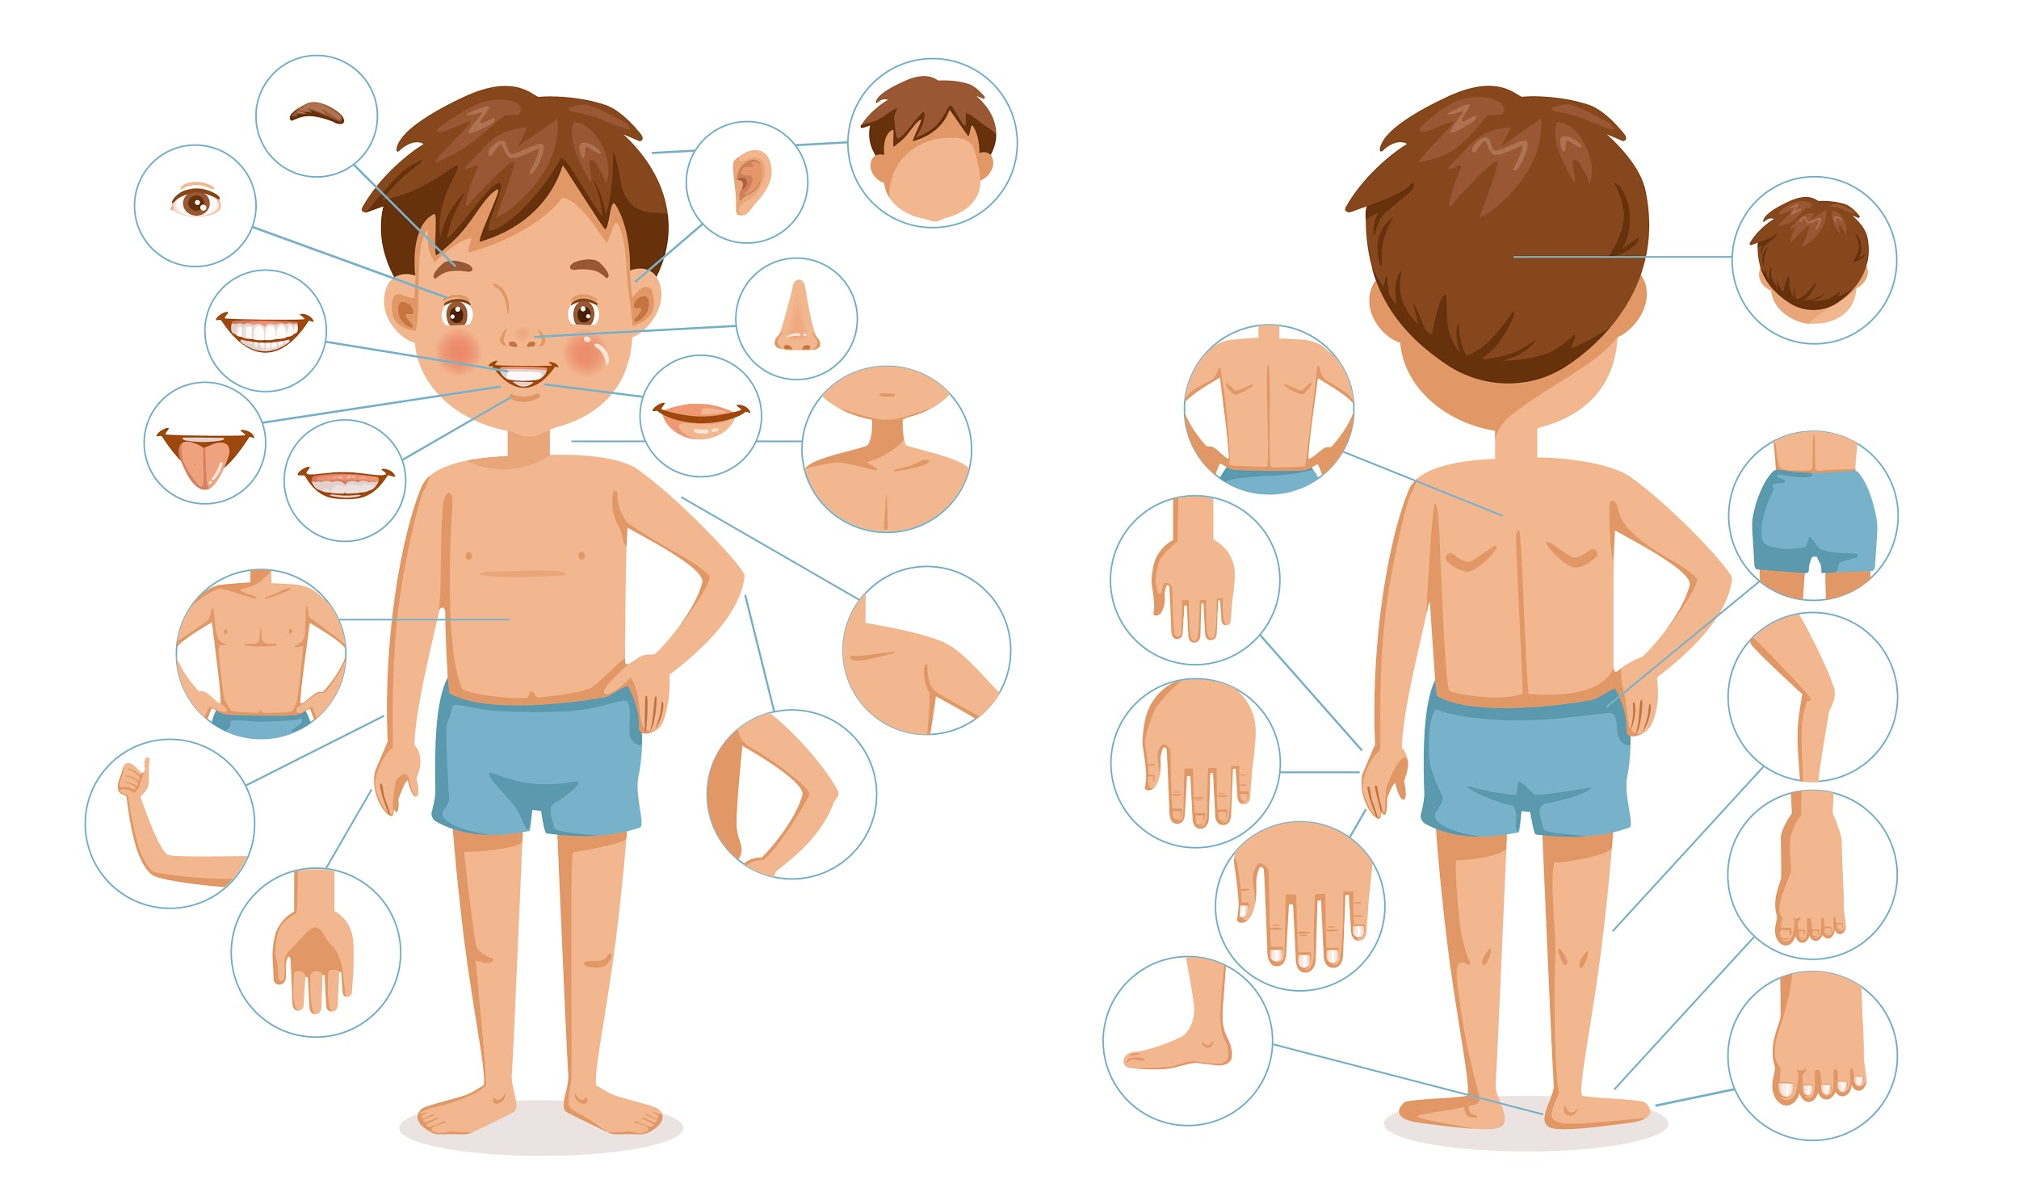
Introduction to HTML
HTML Elements and Attributes

Slide 33
Poll 6 (15 Sec)
Which of the following statements about attributes is true?
(More than one option may be correct.)
They contain the content of the HTML elements.
They provide additional information about the HTML elements.
They are always declared in the end tag.
They always come in name-value pairs.
Practice in teams of 4 students
Industry expert mentoring to learn better
Get personalised feedback for improvements
30

Slide 34
Poll 6 (Answer)
Which of the following statements about attributes is true?
(More than one option may be correct.)
They contain the content of the HTML elements.
They provide additional information about the HTML elements.
They are always declared in the end tag.
They always come in name-value pairs.
Practice in teams of 4 students
Industry expert mentoring to learn better
Get personalised feedback for improvements
31

Slide 35
Poll 7 (15 Sec)
Which of the following statements about the ID attribute of an element is true?
(More than one option may be correct.)
It is unique for an element.
It is not unique for an element.
It is an attribute of an element.
It is an element.
Practice in teams of 4 students
Industry expert mentoring to learn better
Get personalised feedback for improvements
32

Slide 36
Poll 7(Answer)
Which of the following statements about the ID attribute of an element is true?
(More than one option may be correct.)
It is unique for an element.
It is not unique for an element.
It is an attribute of an element.
It is an element.
Practice in teams of 4 students
Industry expert mentoring to learn better
Get personalised feedback for improvements
33

Slide 37
Poll 8(15 Sec)
Which of the following statements about the class of an element is true? (More than one option may be correct.)
It is unique for an element.
It is not unique for an element.
It is an attribute of an element.
It is an element.
Practice in teams of 4 students
Industry expert mentoring to learn better
Get personalised feedback for improvements
34

Slide 38
Poll 8(Answer)
Which of the following statements about the class of an element is true?
(More than one option may be correct.)
It is unique for an element.
It is not unique for an element.
It is an attribute of an element.
It is an element.
Practice in teams of 4 students
Industry expert mentoring to learn better
Get personalised feedback for improvements
35

Slide 39
Character Entities
Introduction to HTML

Slide 40
Introduction to HTML
Character Entities
An HTMl entity is basically a text that starts with an ampersand(&) and ends with a semicolon(;).
This entities are often used to display the reserved characters. i.e. the characters which otherwise would be interpreted as simple HTM: code.
Some commonly used characters and their entities are:
Character | Entity | Description
& | &amp; | It symbolizes the beginning of an character entity.
< | &lt; | It is used to represent the opening tag.
> | &gt; | It is used to represent the closing tag.
“ | &quot; | It is used to represent the start and end of attribute value.
You can find the documentation link for reference here

Slide 41
Inline and Block Elements
Introduction to HTML

Slide 42

Introduction to HTML
Inline Elements

Slide 43
Introduction to HTML
Inline Elements
<span> is an example of inline element.
<html> <head> <title>Session 1</title> </head> <body> <!-- Inline Elements --> <span>This is a &lt;span&gt; element.</span> <span>This is an inline element.</span> <span> If you inspect this element, </span> <span>you will notice it occupies only the width of its content.</span> </span> </body> </html>
You can find the documentation link for reference here

Slide 44

Introduction to HTML
Block Elements

Slide 45

Introduction to HTML
Block Elements
<div> and <p> are examples of block elements
<html> <head> <title>Session 1</title> </head> <body> <!-- Block Elements --> <div class="container"> &lt;div&gt; is a block element. If you inspect this element using Dev Console, you will see it occupies an entire line of the window. </div> <p id="para">This is a &lt;p&gt; element. This is also a block element. If you inspect this element using Dev Console, you will see it occupies an entire line of the window. </p> </body> </html>
You can find the documentation link for <div> here
You can find the documentation link for <p> here

Slide 46
Introduction to HTML
Inline and Block Elements
Inline Elements | Block Elements
<span> | <div>
<b> | <p>
<strong> | <h1> …. <h6>
<i> | <hr>
<em> | <table>
<a> | <ul>
<img> | <ol>
<button> … | <form>
You can see the entire list here. | You can see the entire list here.

Slide 47
Poll 9(15 Sec)
Which of the following statements about inline elements is true?
(More than one option may be correct.)
They appear on the next line by default.
They appear on the same line by default.
<span> is an inline element.
<div> is an inline element.
Practice in teams of 4 students
Industry expert mentoring to learn better
Get personalised feedback for improvements
41

Slide 48
Poll 9(Answer)
Which of the following statements about inline elements is true?
(More than one option may be correct.)
They appear on the next line by default.
They appear on the same line by default.
<span> is an inline element.
<div> is an inline element.
Practice in teams of 4 students
Industry expert mentoring to learn better
Get personalised feedback for improvements
42

Slide 49
Poll 10(15 Sec)
Which of the following statements about block elements is true?
(More than one option may be correct.)
They appear on the next line by default.
They appear on the same line by default.
<span> is a block element.
<div> is a block element.
Practice in teams of 4 students
Industry expert mentoring to learn better
Get personalised feedback for improvements
43

Slide 50
Poll 10(Answer)
Which of the following statements about block elements is true?
(More than one option may be correct.)
They appear on the next line by default.
They appear on the same line by default.
<span> is a block element.
<div> is a block element.
Practice in teams of 4 students
Industry expert mentoring to learn better
Get personalised feedback for improvements
44

Slide 51
Doubt Clearance (5 min)

Slide 52
Commonly-Used HTML Elements
Introduction to HTML

Slide 53
Poll 11(15 Sec)
Which of the following is the correct way of writing comments in HTML?
// This is a comment
/* This is a comment */
<!-- This is a comment -- >
<!-- This is a comment
Practice in teams of 4 students
Industry expert mentoring to learn better
Get personalised feedback for improvements
47

Slide 54
Poll 11(Answer)
Which of the following is the correct way of writing comments in HTML?
// This is a comment
/* This is a comment */
<!-- This is a comment -- >
<!-- This is a comment
Practice in teams of 4 students
Industry expert mentoring to learn better
Get personalised feedback for improvements
48

Slide 55
Introduction to HTML
Commonly Used HTML Elements
<h1>…<h6>: They create headers of different sizes.
.
<html> <head> <title>First HTML Page </title> </head> <body> <!-- HTML headings --> <h1>Welcome to upGrad</h1> <h2>Welcome to upGrad</h2> <h3>Welcome to upGrad</h3> <h4>Welcome to upGrad</h4> <h5>Welcome to upGrad</h5> <h6>Welcome to upGrad</h6> </body> </html>
You can find the documentation link for reference here

Slide 56
Poll 12(15 Sec)
Which of the following is the correct tag for the largest heading in HTML?
<h6>
<h4>
<h3>
<h1>
Practice in teams of 4 students
Industry expert mentoring to learn better
Get personalised feedback for improvements
50

Slide 57
Poll 12(Answer)
Which of the following is the correct tag for the largest heading in HTML?
<h6>
<h4>
<h3>
<h1>
Practice in teams of 4 students
Industry expert mentoring to learn better
Get personalised feedback for improvements
51

Slide 58
Introduction to HTML
Commonly Used HTML Elements
<p>: It creates a paragraph text.
<b>, <i>, <strong>, <em>: They give certain styling to the text.
<html> <head> <title>Bold and Italicized</title> </head> <body> <!-- HTML paragraph --> <p>This is a normal paragraph.</p> <p><b>This paragraph is emboldened using the &lt;b&gt; tag.</b></p> <p><strong>This paragraph is emboldened using the &lt;strong&gt; tag.</strong></p> <p>The difference between &lt;strong&gt; and &lt;b&gt; is that strong is a semantic element.</p> <p><i>This paragraph is italicized using the &lt;i&gt; tag.</i></p> <p><em>This paragraph is italicized using the &lt;em&gt; tag.</em></p> <p>The difference between &lt;em&gt; and &lt;i&gt; is that em is a semantic element.</p> </body> </html>

Slide 59
Poll 13(15 Sec)
Which of the following is/are a semantic element(s)?
(More than one option can be correct.)
<p>
<br>
<strong>
<em>
Practice in teams of 4 students
Industry expert mentoring to learn better
Get personalised feedback for improvements
53

Slide 60
Poll 13(Answer)
Which of the following is/are a semantic element(s)?
(More than one option can be correct.)
<p>
<br>
<strong>
<em>
Practice in teams of 4 students
Industry expert mentoring to learn better
Get personalised feedback for improvements
54

Slide 61
Introduction to HTML
Commonly Used HTML Elements
<br />: It creates a new line.
<html> <head> <title>Break Tag</title> </head> <body> <div id="container1"> <p>With &lt;br&gt; :</p> <span>First line</span> <br /> <span>Second line</span> </div> </body> </html>
You can find the documentation link for reference here

Slide 62
Poll 14(15 Sec)
State yes or no.
Is the <br /> tag an empty element?
Yes
No
Practice in teams of 4 students
Industry expert mentoring to learn better
Get personalised feedback for improvements
56

Slide 63
Poll 14(Answer)
State yes or no.
Is the <br /> tag an empty element?
Yes
No
Practice in teams of 4 students
Industry expert mentoring to learn better
Get personalised feedback for improvements
57

Slide 64
Introduction to HTML
Commonly Used HTML Elements
<img />: It creates an image element.
<html> <head> <title>Images</title> </head> <body> <!-- HTML Image --> <img src="https://wallpaperplay.com/walls/full/9/e/0/43067.jpg" alt="An image of car" height="450" width="600" /> </body> </html>
You can find the documentation link for reference here

Slide 65
Introduction to HTML
Commonly Used HTML Elements
<a>: It creates an anchor tag, which is an element used to open different pages or go to different locations.
<html> <head> <title>Anchor Tag</title> </head> <body> <!-- HTML anchor tag --> <a href="https://google.com">This link has no target mentioned. It will by default open Google on this tab.</a> <br/> <a href="https://google.com" target="_self">This link has <kbd>target="_self"</kbd>. It will open Google on this tab.</a> <br /> <a href="https://google.com" target="_blank">This link has <kbd>target="_blank"</kbd>. It will open Google in a new tab.</a> </body> </html>
You can find the documentation link for reference here

Slide 66
Poll 15(15 Sec)
State yes or no.
Does a hyperlink apply only to text?
Yes
No
Practice in teams of 4 students
Industry expert mentoring to learn better
Get personalised feedback for improvements
60

Slide 67
Poll 15(Answer)
State yes or no.
Does a hyperlink apply only to text?
Yes
No
Practice in teams of 4 students
Industry expert mentoring to learn better
Get personalised feedback for improvements
61

Slide 68
2
Poll 16(15 Sec)
How can you open a link in a new tab?
<a href=”https://www.upgrad.com/” target=”blank”>
<a href=”https://www.upgrad.com/” target=”_self”>
<a href=”https://www.upgrad.com/” target=”_blank”>
<a href=”https://www.upgrad.com/” target=”self”>
Practice in teams of 4 students
Industry expert mentoring to learn better
Get personalised feedback for improvements
62

Slide 69
Poll 16(Answer)
How can you open a link in a new tab?
<a href=”https://www.upgrad.com/” target=”blank”>
<a href=”https://www.upgrad.com/” target=”_self”>
<a href=”https://www.upgrad.com/” target=”_blank”>
<a href=”https://www.upgrad.com/” target=”self”>
Practice in teams of 4 students
Industry expert mentoring to learn better
Get personalised feedback for improvements
63

Slide 70
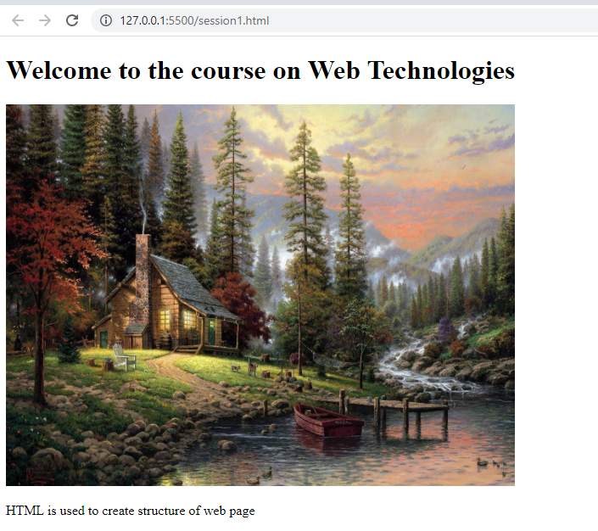
Hands-On Exercise (3 min)
Write an HTML program which outputs as shown in the image:
The elements of the HTML program are as follows:
The heading should be the largest.
The source of the image is as follows: https://wallpaperplay.com/walls/full/c/8/f/12935.jpg#.Xs6BGNp_478.link
The height of the image should be 450 and the width should be 600.
The image, when clicked, should redirect you to the following website:
https://www.upgrad.com/
The paragraph tag should have id as ‘paragraph’ and the text should be as shown in this image.
For the stub code, click here.
For the solution, click here.

Slide 71
Key Takeaways
Front-end web development involves the creation of the most important aspect of a website: the visual part.
A website or any web application comprises three important constituents: foundation, style and functionality.
HTML is a language that is used to create the foundation and structure of a website, while CSS and JS focus on the style and functionality of a website, respectively.
Using HTML, you can create various elements, such as headers, texts and images.

Slide 72
Doubt Clearance (5 min)

Slide 73
Tasks to Complete After Today’s Session
MCQs
Coding Questions
Project: Checkpoint 1

Slide 74
In the next class, you will learn...
How to create tables in HTML?
How to create lists in HTML?
How to create a dropdown list in HTML?
How to show YouTube videos on your website?
Begin the development of the Recipes Website

Slide 75
#RahoAmbitious
Thank You!

